Slide 1




SAHAYOG

Slide 2



INTRODUCTION
Delayed Payments
Lack of Transparency
Delayed Harvests
Labor Shortages
No Skill-Based Allocation
Communication
Gaps
High Labor Costs
Middlemen Exploitation
Seasonal Employment
Migration Issues
Low Productivity Tracking
Unpredictable Availability
Poor Working Conditions

Slide 3

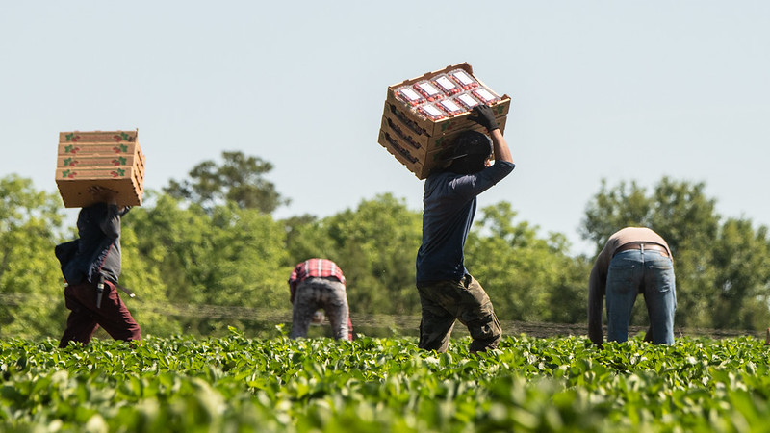
PROBLEM
STATEMENT
Farmers struggle to find reliable labor when needed, while unemployed workers lack easy access to job opportunities in agriculture leading to delayed harvests, financial losses and inefficiencies.

Slide 4
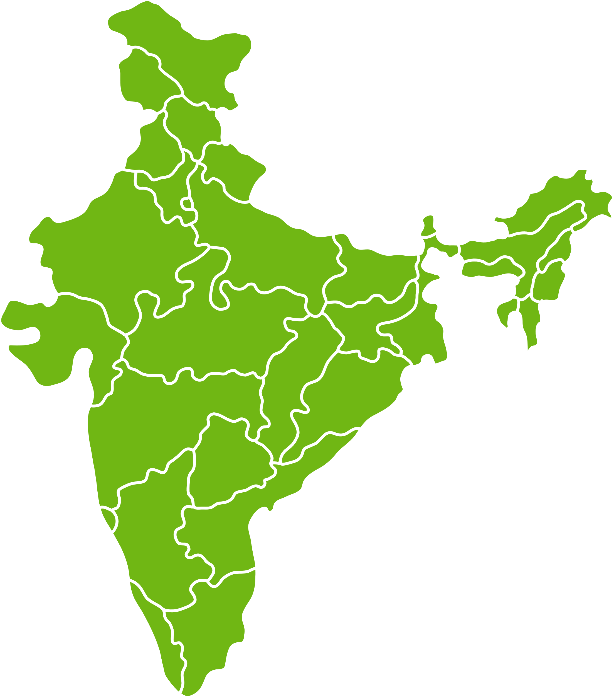
Rajasthan
Madhya Pradesh
Crop loss: 10.65%
Unemployment: 4.4%
Migration: 21.9%
Crop loss: 10.75%
Unemployment : 1.6%
Migration : 19.8%
Odisha
Maharashtra
Crop loss: 2.08%
Unemployment : 3.9%
Migration : 18.8%
Crop loss: 5.24%
Unemployment: 3.1%
Migration : 19.8%
Andra Pradesh
Crop loss: 2.07%
Unemployment : 4.1%
Migration : 27.6%
Karnataka
Crop loss: 9.05%
Unemployment : 2.4%
Migration : 17.82%
Tamil Nadu
Crop loss: 2.08%
Unemployment : 4.3%
Migration : 20.4%

Slide 5

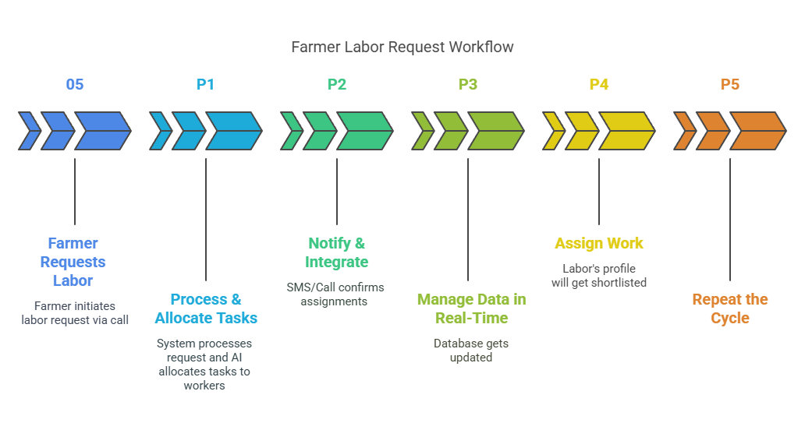
PROBLEM
Solution

Slide 6
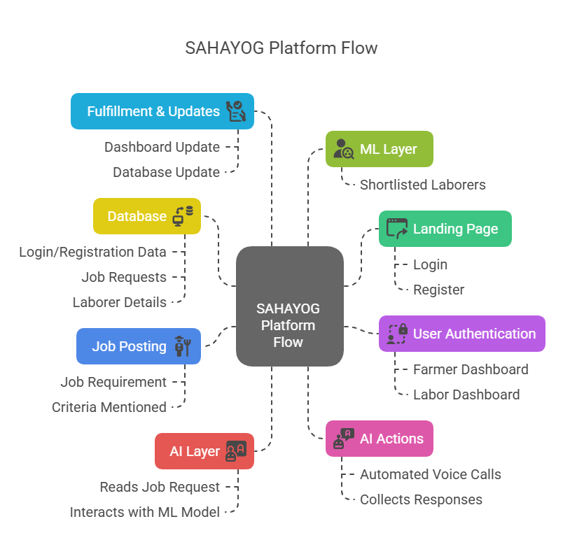
FLOW

Slide 7
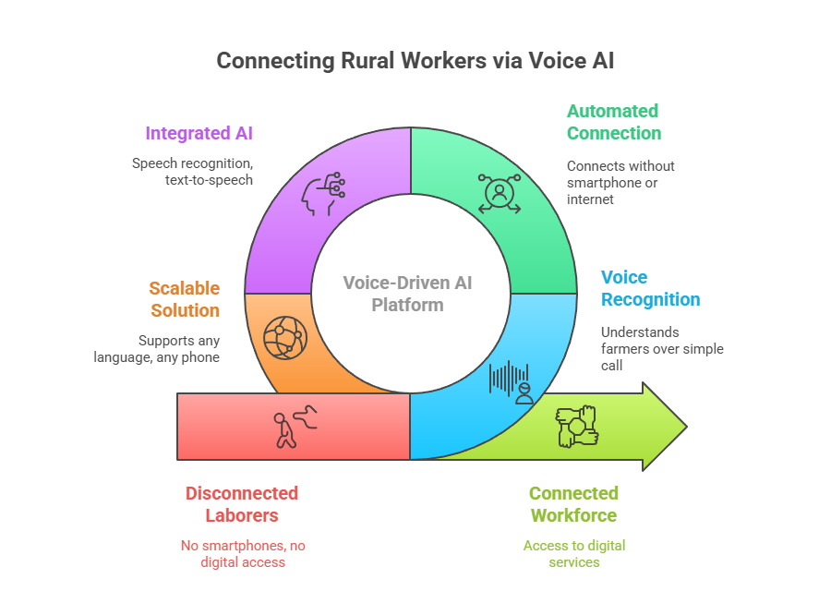

Slide 8
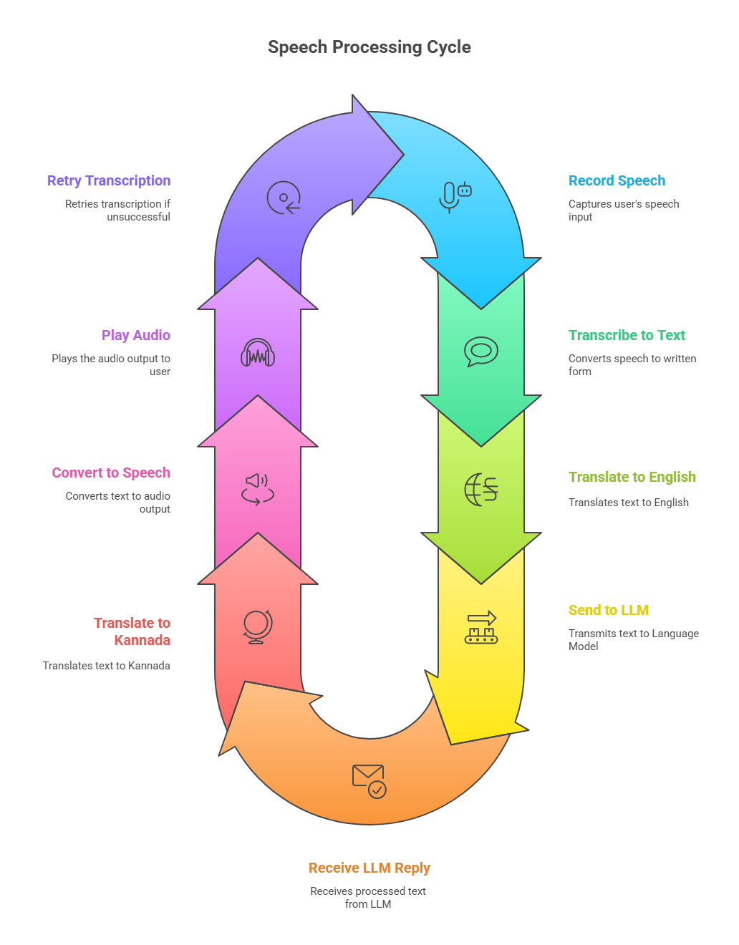
SPEECH PROCESSING CYCLE

Slide 9
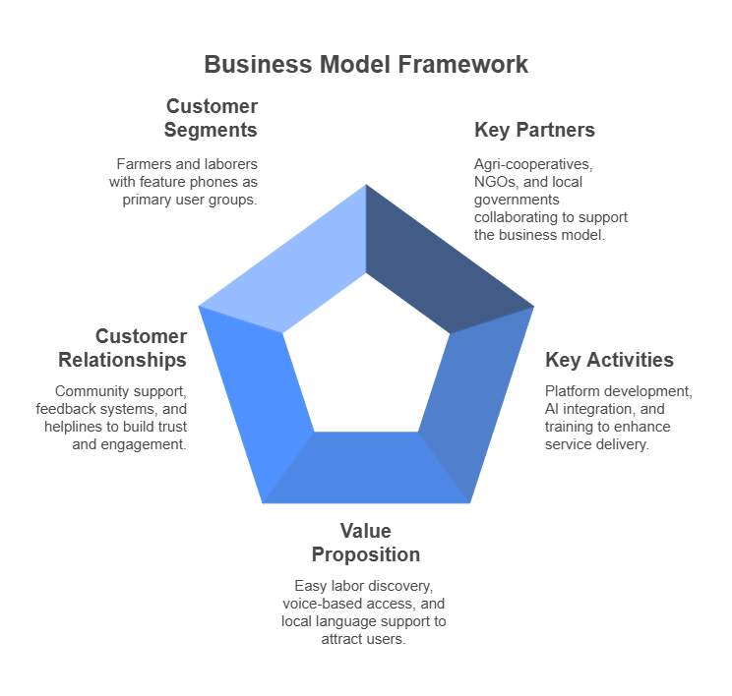
BUSINESS MODEL
FRAMEWORK

Slide 10



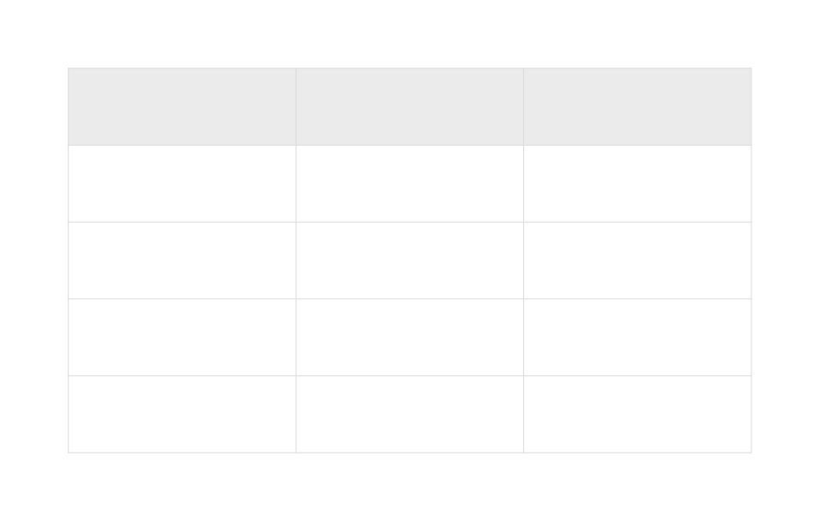
Competitive
Analysis
Feature | Our Webapp | Local Labor Brokers | Whatsapp Groups | Job Portals
IVR
Local Language Support
Ratings
Direct Negotiation
No Internet Required
Scalable/Automated

Slide 11
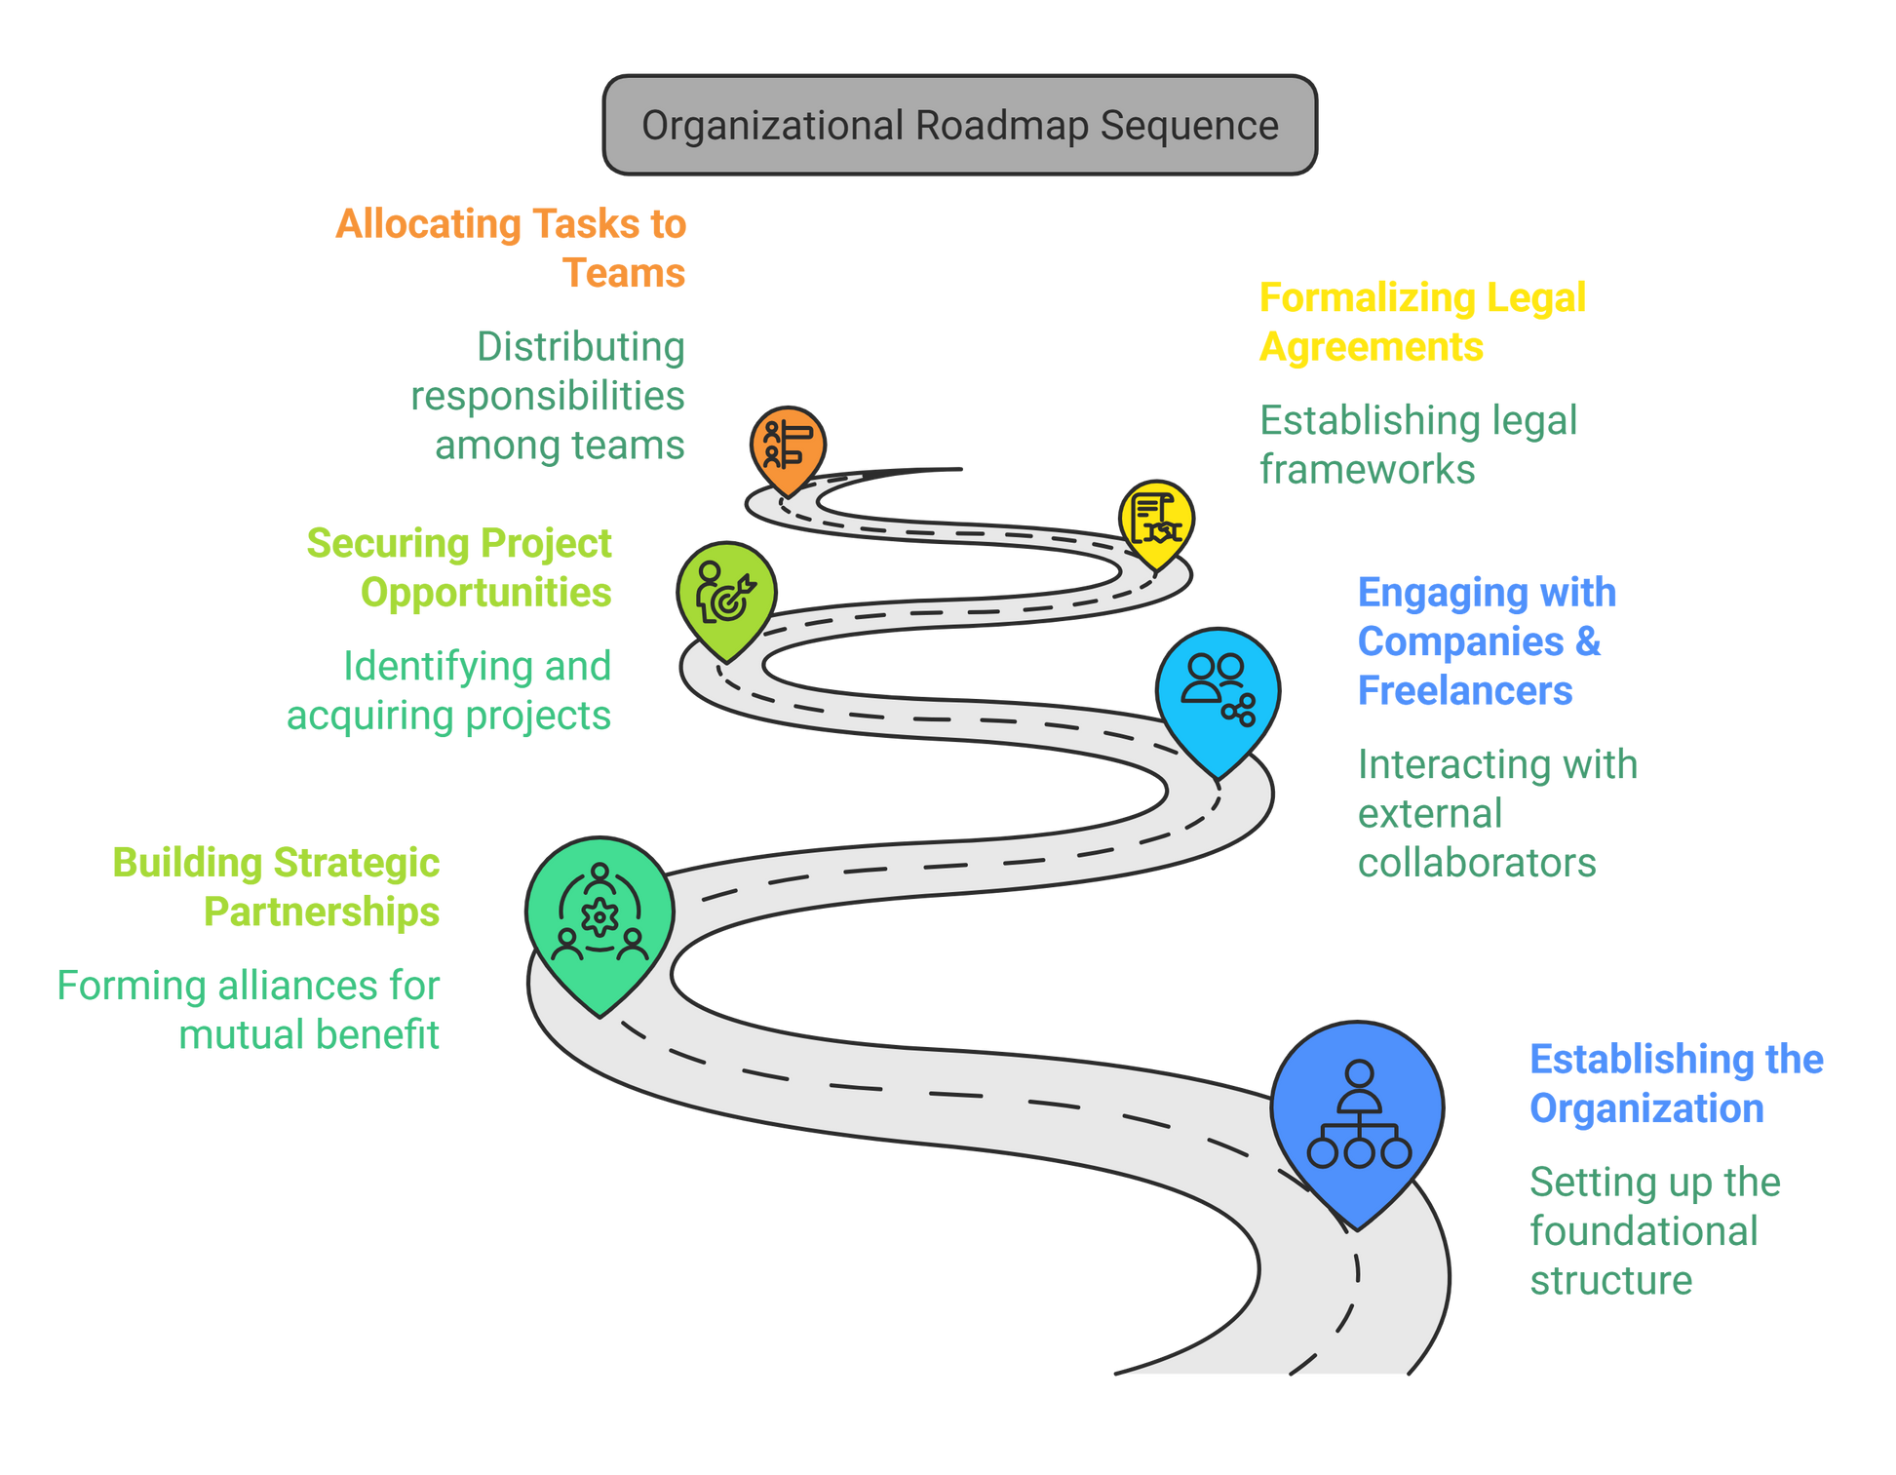
MILESTONES

Slide 12
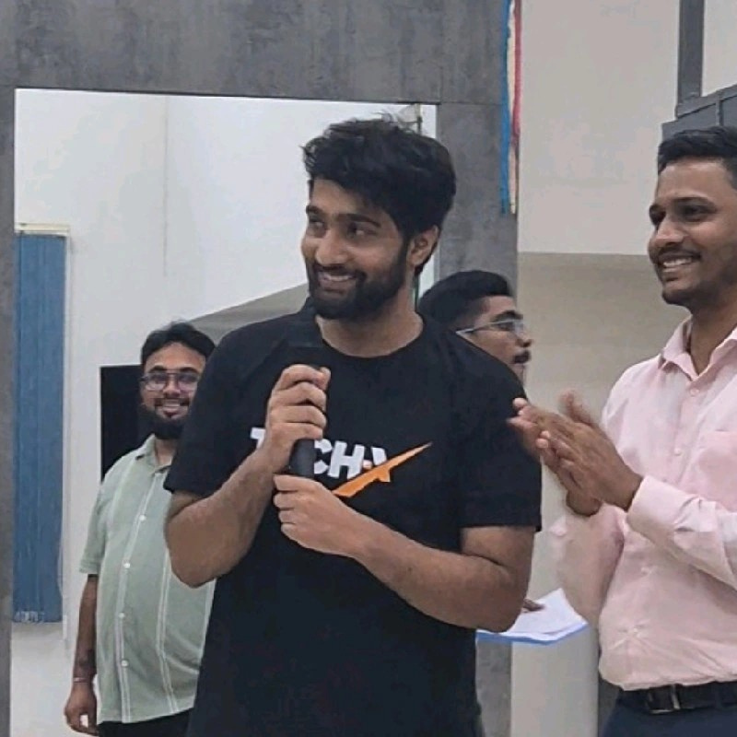



Our Team
Charan N
Gowtham K
Akash B
Charan V

Slide 13




THANK
YOU

